Slide 1
Creating Goals and Objectives

Slide 2
Goals
Goals are broad statements of what the students will be able to do when they have completed the lesson
Goals can be lofty ideas, using words or phrases like "appreciates" or "shows leadership ability."

Slide 3
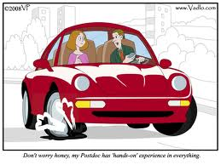
Goals Example
Students will understand the steps needed to fix a flat tire

Slide 4
Objectives
Measurable objectives are the specific measures we use to determine whether or not we are successful in achieving the goal
The objectives are instructions about what we want the student to be able to do.
Use verbs and include specific conditions (how well or how many) that describe to what degree the students will be able to demonstrate mastery of the task.

Slide 5
Objectives
Measurable objectives are used as assessment tools.
Once the objective is defined, this then becomes the foundation for your grading or assessment policy

Slide 6
Goals Example
Students will understand the steps needed to fix a flat tire

Slide 7
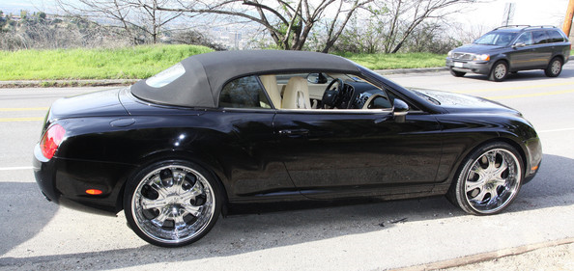
Objective Example
1. Student will list three points to remember when pulling to the side of the road.

Slide 8
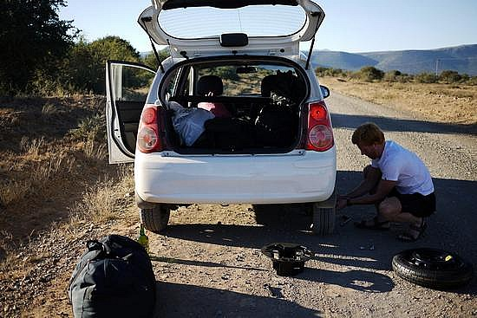
Objective Example
2 . Student will explain where to find and how to safely place the car jack.

Slide 9
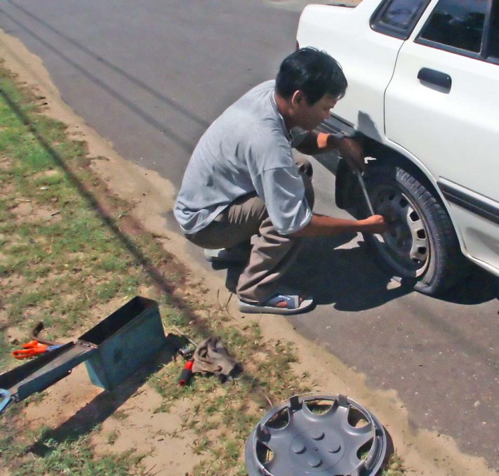
Objective Example
3. Student will explain how to remove the lug nuts and flat tire.

Slide 10
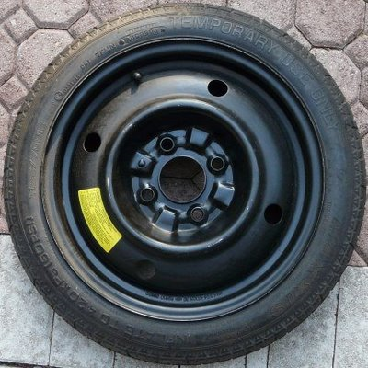
Objective Example
4 . Using the image below students will provide a definition of the type of spare and it’s limitations.

Slide 11
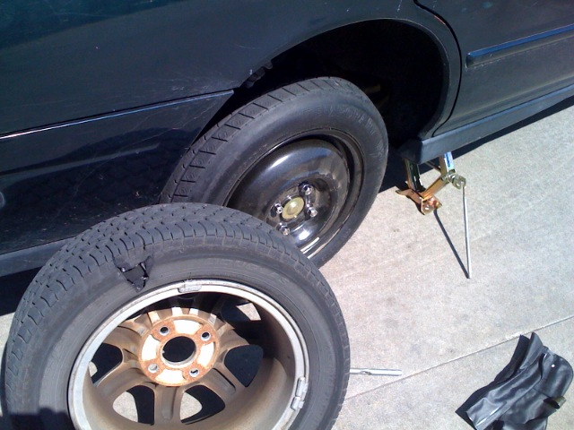
Objective Example
4. Students will list the steps in placing the spare on the car and removing the jack.

Slide 12
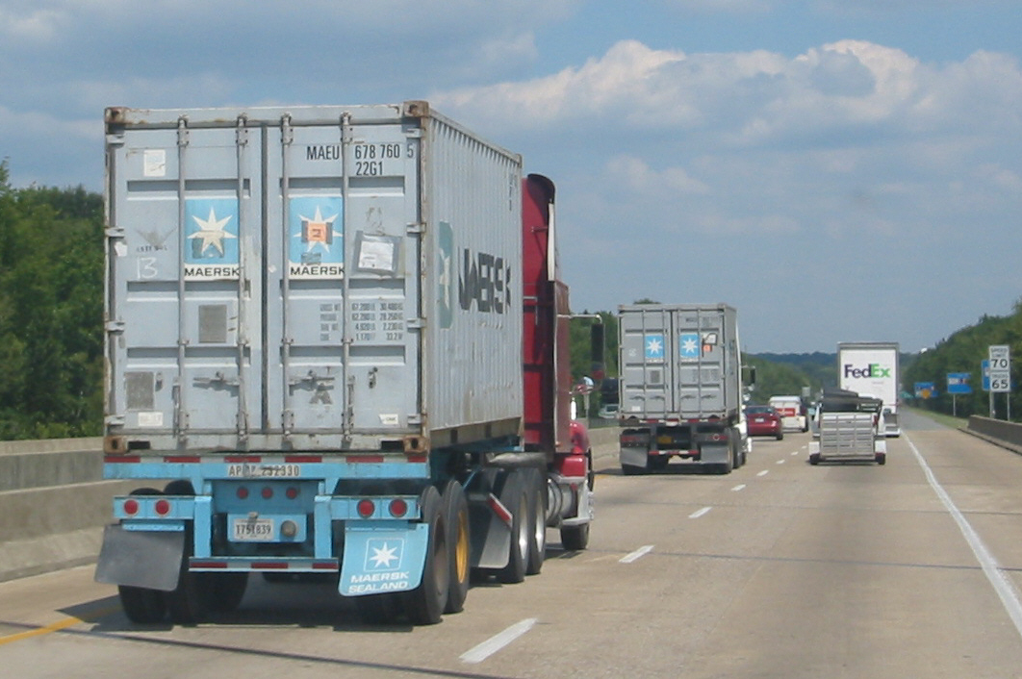
Objective Example
5. Students will list the steps in to safely re-enter the highway.

Slide 13
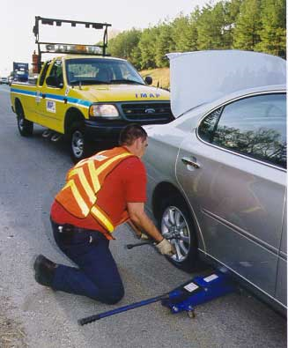
Alternative Objective Example
1. Students will list the steps in calling for help.

